Slide 1
Seizures and Epilepsy in Severe Autism
Stephanie M. Morris, M.D.
Medical Director, Assistant Professor of Neurology
Center for Autism Services, Science and Innovation (CASSI)
Kennedy Krieger Institute

Slide 2
Disclosure Slide
I have no actual or potential financial or non-financial conflicts of interest in relation to this presentation.

Slide 3
Objectives
Review the prevalence of seizures/epilepsy in autism
Identify risk factors for development of epilepsy in autistic individuals
Review what a seizure is and the various seizure types
Review how a diagnosis of epilepsy is made
Outline what to do when a seizure occurs (Seizure First Aid)
Review the medical evaluation of seizures – EEG and MRI
Discuss EEG abnormalities in autism including ESES and the association with regression syndromes
Review the treatment of epilepsy
Discuss SUDEP – sudden unexplained death in epilepsy
Helpful tips

Slide 4
Why should we care about seizures?
Rate of epilepsy in ALL autistic individuals is approximately 20%
Rate of epilepsy in the general population is ~1%
Rate of epilepsy is significantly higher in autistic individuals with co-occurring intellectual disability
Highest rate of epilepsy in autistic individuals whose IQ is <40 at ~46%
Study in 2013 (Viscidi et. al.) using a sample of 5185 autistic children over the age of 10 years old demonstrated that for every 10-point increase in IQ, the odds of having epilepsy decrease by 47%
Individuals with profound autism are at highest risk for developing seizures

Slide 5
Genetic Link – Autism, Intellectual Disability, and Epilepsy
In recent years, owing to the rapid progress of genomic technologies, many genetic variants have been identified that confer increased risk for autism, intellectual disability, and epilepsy
Although not completely understood, three proposed biological models provide possible explanations for this association
Neurodevelopmental and epileptic phenotypes arise from the same genetic risk and biological pathways
Neurodevelopmental-like symptoms arise secondary to epileptic seizures and epileptiform abnormalities
Neurodevelopmental and epileptic phenotypes develop independently by chance without causality

Slide 6
Beyond IQ – Other Risk Factors
Isolated regression (loss of developmental skill) in language
Late-onset (>3 years old) regression in language, social, and cognitive skills
Age
Two peaks: infancy and adolescence
In those without infantile-onset of epilepsy, risk for epilepsy increases over time with peak in adolescence and continues until the 3rd decade of life
Possibly Female sex
Attenuated male-to-female ratio of autism in those with epilepsy of 2:1, compared to 3.5:1 in those without epilepsy

Slide 7
Epilepsy is unpredictable
Despite identifiable risk factors, the development of epilepsy in any one individual is unpredictable
We don’t yet have any reliable predictive markers to help determine who will develop epilepsy, so we rely on clinical clues to help identify seizures
There are many genetic conditions that are highly associated with both epilepsy and autism; however, even within these conditions, the development of epilepsy or autism is not guaranteed

Slide 8
What is a seizure?
Sudden, uncontrolled electrical disturbance in the brain that can cause changes in behavior, movements, feelings, and consciousness
Seizures can last for seconds, minutes, or hours
They can occur at any time of day or night
An individual can have multiple different seizure types, but each distinct seizure type typically looks the same way each time when it occurs (“stereotyped”)

Slide 9
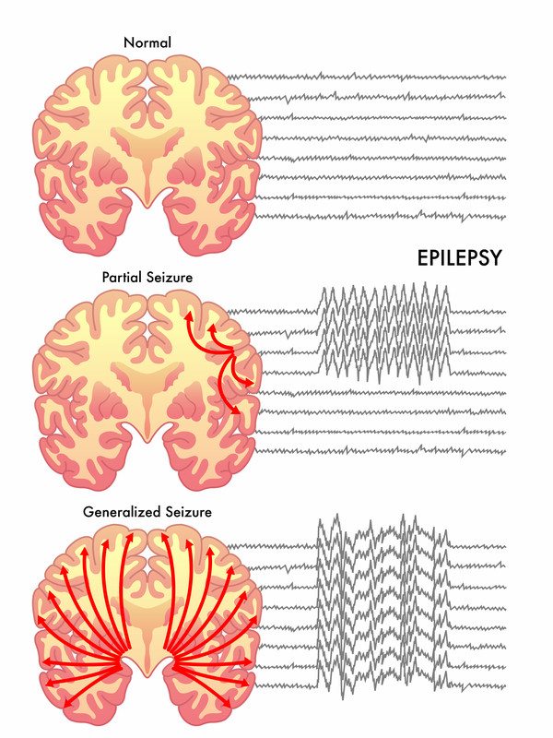
Seizure Types
Classified into 2 distinct categories: Generalized and Focal (Partial)
Focal seizures: Occur from abnormal electrical activity in 1 area of the brain
Generalized seizures: Occur from abnormal electrical activity that involves the entire brain

Slide 10
Focal/Partial Seizures
Focal seizures are further classified into 2 categories: Focal seizures with impaired awareness and focal seizures without impaired awareness
Focal seizures with impaired awareness – involve a change or loss of consciousness
Focal seizures without impaired awareness – preserved consciousness and awareness of the seizure

Slide 11
Focal Seizures – What do they look like?
Focal seizures with impaired awareness
Eyes open but staring off and not responding to environment
Appear awake but confused repeating certain words, walking in circles, rubbing clothing, engaging in unusual behavior
Eyes looking towards one side or rolled upwards
Repetitive jerking movements of the face, arm/hand, leg/foot on one side of the body
Stiffness involving the face, arm/hand, leg/foot on one side of the body
There is usually no memory of the seizure or awareness that it occurred

Slide 12
Focal Seizures – What do they look like?
Focal seizures without impaired awareness
Sudden change in emotion – feeling sad, angry, or joyful
Tingling or discomfort in face, arm/head, leg/foot on one side of the body
Repetitive jerking movements of the face, arm/head, leg/foot on one side of the body
Flashing lights or colors
Sense of nausea or stomach upset
The individual is aware during the seizure and has memory of the event – may rely on the reporting of the symptoms by the individual if not otherwise clinically apparent
Focal seizures can be very challenging to identify clinically when symptoms are obscure, not clinically visible, and mimic behaviors that can be observed in the context of autism alone

Slide 13
Generalized Seizures
Generalized seizures are classified into various types:
Absence seizures
Atonic seizures
Myoclonic seizures
Tonic seizures
Clonic seizures
Tonic-clonic seizures
Focal seizures can also spread to involve the entire brain and result in a “secondarily generalized seizure”

Slide 14
Generalized Seizures – What do they look like?
Absence Seizures (aka Petit Mal Seizures):
Eyes open and staring off, sometimes with lip smacking or eye lid fluttering
Usually last for 5-10 seconds with rapid return to baseline
Can occur up to hundreds of times a day and often occur in clusters
Atonic Seizures (aka Drop Seizures):
Sudden, brief loss of muscle control resulting in a rapid fall to the ground or drop of the head
Myoclonic Seizures:
Sudden, brief jerks or twitches involving the arms or legs
Usually without loss of consciousness

Slide 15
Generalized Seizures – What do they look like?
Tonic Seizures:
Stiffening of the entire body, typically involving the jaw, torso, hands, arms, legs, and feet
Associated with loss of consciousness and often fall to the ground
Clonic Seizures:
Repetitive jerking involving the neck, face, and arms on both side of the body
Tonic-Clonic Seizures (aka Grand Mal Seizures):
Sudden loss of consciousness with whole body stiffening followed by repetitive jerking of the face, neck, arms, and legs
Often associated with loss of bladder/bowel control and biting of the tongue due to jaw clenching

Slide 16
What causes seizures?
Seizures can be caused or triggered by many different things including:
Brain injury
Alcohol or drug use/withdrawal
Metabolic disturbances (electrolyte imbalance, kidney/liver dysfunction)
High fevers
Meningitis
Stroke
Brain tumors
Medications
However, the most common cause of recurrent seizures is epilepsy

Slide 17
Making a diagnosis of epilepsy
Epilepsy is a chronic neurological disorder characterized by recurrent seizures
A diagnosis of epilepsy can be made when:
an individual has 2 or more seizures, occurring more than 24 hours apart, without any clear provoking or triggering factor, OR
an individual has 1 unprovoked seizure and is determined to have at least a 60% probability of having another one within the next 10 years

Slide 18
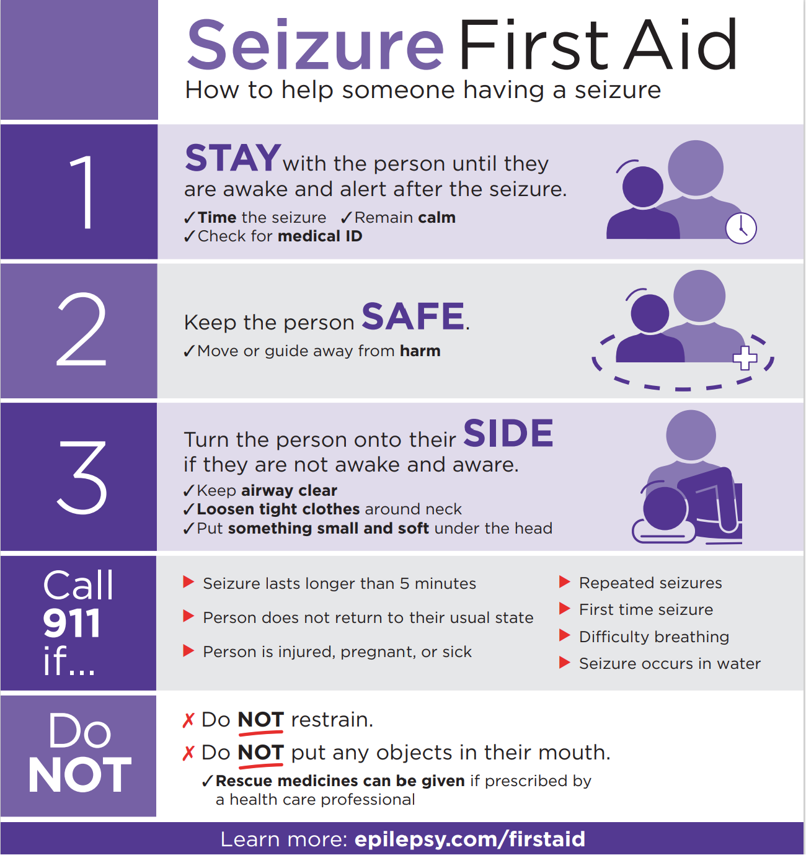
Most seizures are self-limited and basic first aid is all that is required
When helping somebody who is having a seizure, remember:
STAY
SAFE
SIDE

Slide 19
How long is too long?
Most seizures last less than 5 minutes and stop on their own
A seizure that lasts for longer than 5 minutes is considered a prolonged seizure and is referred to as “status epilepticus”
Brief seizures that occur back-to-back without return to baseline lasting more than 5 minutes (prolonged seizure clustering) is also considered “status epilepticus”
Status epilepticus is considered a medical emergency

Slide 20
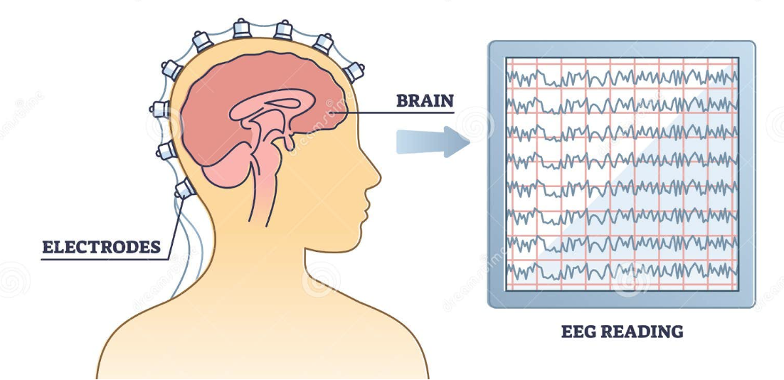
Medical Evaluation for Suspected Seizures
Electroencephalography (EEG)
Involves the placement of electrodes on the scalp to record the electrical activity generated by neurons in the brain
Abnormal EEG signals can include electrical “discharges” that are not typically seen when neurons are communicating properly
Abnormal EEG discharges are called “epileptiform activity” and can indicate an underlying predisposition for seizures

Slide 21
EEG Abnormalities in Autism
Although prevalence rates vary, it is estimated that 20-60% of autistic individuals have epileptiform discharges on their EEG, even in the absence of clinical seizures
General population estimates of epileptiform abnormalities without clinical seizures is ~1-4%
There is no characteristic EEG pattern for autism
Epileptiform abnormalities in autistic individuals can be focal, generalized, multi-focal, occurring on one side or both sides of the brain

Slide 22
Electrical Status Epilepticus During Sleep (ESES)
In children with a history of developmental regression, EEG will sometimes be used to evaluate for the presence of a specific and severe EEG abnormality called ESES that is associated with rare conditions such as Landau-Kleffner Syndrome (LKS) or Continuous Spike-Waves in Slow-Wave Sleep (CSWS) Syndrome
In both LKS and CSWS, children present with typical early language development followed by a significant regression in language skills, often also accompanied by regression in social skills, cognition, and/or motor coordination (in CSWS)
Overnight EEG is required to establish these diagnoses given that the profound EEG abnormalities needed for diagnosis occur during sleep

Slide 23
Autistic Regression or LKS/CSWS
Developmental regression in children with autism is most commonly NOT associated with a regressive syndrome like LKS or CSWS, and is most often a result of “autistic regression”, for which there is no known cause
There are 3 major clinical differences between children who experience autistic regression and those with a regressive syndrome like LKS or CSWS
Age of Onset
Features of Regression
EEG Findings

Slide 24
#1: Age of Onset
Average age of language and/or social regression in autism is 18-24 months
Majority of children with autism who experience a regression will do so before the age of 3 years
Regression observed in LKS or CSWS occurs commonly after the age of 3 (considered “late onset”) with only a small fraction – 10-15% - experiencing regression prior to age 3

Slide 25
#2: Features of Regression
Autistic regression typically affects social communication skills, language, and development of repetitive behaviors
Due to the young age in which autistic regression typically occurs, it is often subtle with loss of single words or decreased gesturing
In LKS, regression primarily affects both expressive and receptive language skills
In CSWS, regression is more often global affecting multiple developmental domains including language, social, cognitive, and motor skills

Slide 26
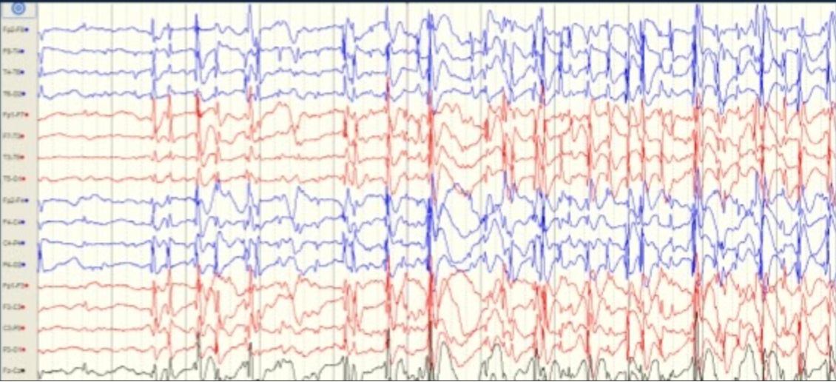
#3: EEG abnormalities
In autism, epileptiform abnormalities associated with regression are often centrotemporal spikes occurring infrequently and intermittently
In LKS and CSWS, the EEG is characterized by frequent temporoparietal spikes occurring during wakefulness that become activated and near-continuous during non-REM sleep indicative of ESES

Slide 27
Current EEG Guidelines
American College of Medical Genetics (ACMG) current practice guidelines provide no guidance regarding the utility of EEG in children with autism
Both the American Academy of Pediatrics (AAP) and the Child Neurology Society (CNS) in collaboration with the American Academy of Neurology (AAN) do not recommend routine testing with EEG in autism given the high frequency of epileptiform abnormalities observed in autistic individuals without clinical seizures
Guidelines currently only support obtaining an EEG for autistic individuals where there is a suspicion for clinical seizures or history of regression

Slide 28
Brain Imaging
Brain imaging with MRI may be recommended for individuals who have focal epileptiform abnormalities identified on EEG
MRI – magnetic resonance imaging – is a non-invasive form of imaging that relies on the use of large magnets rather than radiation to obtain the images
Sedation may be required to minimize movement artifact

Slide 29
What if my child doesn’t tolerate an EEG?
Seizures and epilepsy are both clinical diagnoses and do not require an EEG for diagnosis
An EEG can be helpful in determining the type of seizure or epilepsy, and can also be helpful when there is uncertainty about whether a reported episode is a seizure or not
Sedation can be used during EEG to avoid using restraints, reduce unnecessary anxiety, minimize muscle and movement artifact and accommodate adequate sleep during an EEG
Limitations: availability and medication-effect on EEG findings

Slide 30
Treatment of Seizures
Treatment with anti-seizure medication is recommended when an individual is diagnosed with epilepsy
There are many FDA-approved medications for treatment of epilepsy, some of which are specific to certain genetic conditions that cause both autism and epilepsy, such as Tuberous Sclerosis Complex (TSC)
Treatment is generally guided by seizure-type, age, side effect profile, and underlying cause of the epilepsy, if identified
Sometimes medication may be recommended if there is a high index of suspicion for clinical seizure but can’t be confirmed definitively – “empiric treatment”

Slide 31
A word about anti-seizure medications
Medications used to treat seizures do not cure epilepsy
Help to reduce the likelihood that an individual will have another seizure
Seizures can still occur when an individual is taking an anti-seizure medication (referred to as a “breakthrough seizure”)
Some individuals never achieve seizure control despite taking medication. A person is considered to have “medically refractory” or “drug resistant” epilepsy if they do not achieve seizure control after being on 2 or more medications
Prior to puberty, if a child has been seizure-free for 2 years, an attempt might be made to wean the child off medication

Slide 32
Important Considerations – Anti-Seizure Medications
All anti-seizure medications come in tablet or capsule form; however, not everybody can swallow a tablet or capsule whole
Other formulations available include sprinkles, chewable tablets, and liquid; however, not all medications are available in these forms
Several anti-seizure medications are commonly prescribed off-label for treatment of pediatric bipolar disorder, so may also be beneficial for autistic patients who have co-occurring behavioral dysregulation
Examples: Valproic Acid, Lamotrigine, Carbamazepine, Oxcarbazepine

Slide 33
Emergency “Abortive” Medications
Some individuals are prescribed an emergency or “abortive” medication that can be used to stop a seizure while it happens
Typically prescribed for individuals who have prolonged seizures (>5 minutes), respiratory compromise during seizures, or who have multiple seizures back-to-back (“clustering”) without return to baseline
Emergency medications also come in various formulations including intranasal spray, dissolvable tablet, intramuscular, and rectal
The type of emergency medication prescribed often depends on the individual’s age, size/weight, and seizure type

Slide 34
Sudden Unexplained Death in Epilepsy (SUDEP)
SUDEP is a rare cause of death in individuals with epilepsy (1 in 1,000 per year)
Defined clinically as a “sudden, unexpected, witness or unwitnessed, nontraumatic and non-drowning death in patients with epilepsy, with or without evidence for a seizure and excluding documented status epilepticus, for which no other cause of death can be determined”
Suspected risk factors include: 3 or more generalized tonic-clonic seizures per year, onset of epilepsy in childhood/adolescence, nocturnal seizures, intellectual disability, use of more than 1 anti-seizure medication, and specific genetic causes of epilepsy
Sudden death in autism is often coupled with a history of seizures; however, even in the absence of seizures, unexplained deaths are estimated to be 2.4 times higher in autistic individuals compared to the general population

Slide 35
Seizure Detection Devices
Many seizure detection devices on the market
Pad that goes under the mattress to detect unusual movements
Camera that detect unusual movements during sleep
Pulse oximeters that measure heart rate and oxygen levels during sleep
Wearable watches that detect and record movement
International League Against Epilepsy (ILAE) current practice guidelines recommend wearable devices for detection of tonic-clonic seizures, although clinical benefit remains unknown

Slide 36
Talk to your doctor if you witness:
Any spells of staring with unresponsiveness
Unexplained episodes of bedwetting, blood on a pillowcase, or unexplained injury to the tongue
Sudden episodes of limb stiffening or jerking
Unexplained falls
Unusual or bizarre behavior that is distinctly different than baseline, especially if recurrent
Any loss of previously obtained skills (regression)
Any spell that you think might be seizure

Slide 37
Helpful Tips
If you witness an unusual spell, try to video record it. Your doctor may be able to make a determination about whether an episode is seizure or not by watching the video.
If you witness a staring episode, attempt to get the person’s attention by touching them (tickle, light pinch) or offer an activity that you know typically would garner attention
If your child has seizures, notify their school and have your doctor complete a Seizure Action Plan. Seizures can happen anywhere.
If your child has seizures, talk to your doctor about SUDEP

Slide 38
Questions
Thank you!

