Slide 1
Psychopharm & CIM Treatments for Autism Spectrum Disorder
Robert L Hendren, DO
Professor of Psychiatry and Behavioral Science
April 29,2021

Slide 2
Faculty Disclosure
Research Grants — Curemark, Roche, Otsuka, Axial
Advisory Board — Curemark, BioMarin, Janssen, Axial Therapeutics
Honoraria/Royalties: Oxford University Press, Routledge

Slide 3
Learning Objectives
Review the background for the biomedical treatment of severe autism spectrum disorder (ASD) and briefly review the standard pharmacologic treatments
Critically review several CIM treatments proposed for the treatment of people with ASD using the US Preventive Services Task Force criteria
Describe in more detail the studies with stronger evidence of efficacy for severe ASD.

Slide 4
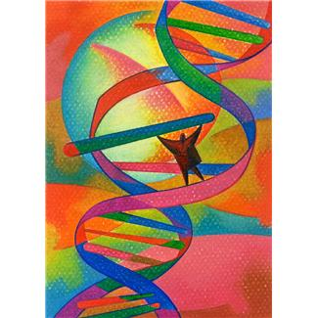
Model for Autism Etiology
First hit – Genetic neurodevelopmental vulnerability
Second hit – Environmental “stressor” and interaction between the two
Third hit – Restricted development

Slide 5
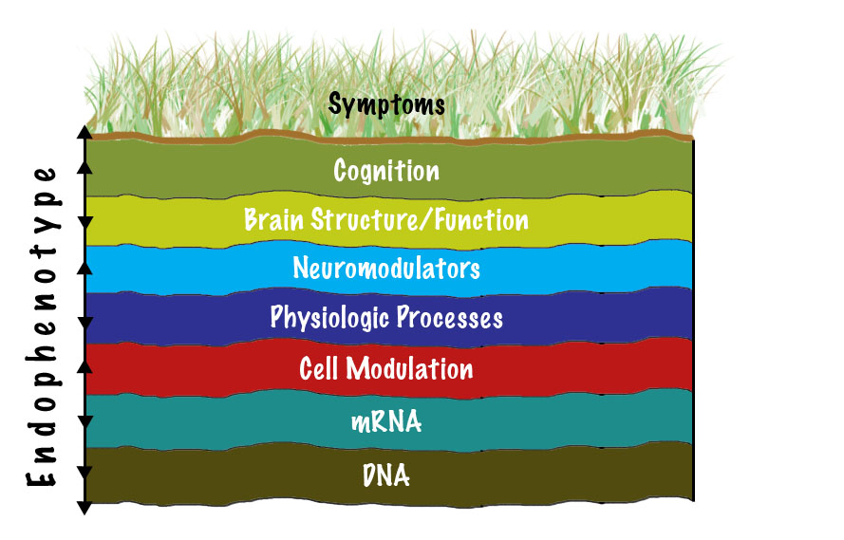
Translating from “Terroir”: Model Epigenetic Layer to Targeted Treatment
Level 4
Level 3
Level 2
Level 1
Hagerman R, Hendren RL (Eds). Treatment of Neurodevelopmental Disorders: Targeting Neurobiological Mechanisms. Oxford University Press; 2014.

Slide 6
Level-Based Interventions
Level 4-Behavioral interventions, family support, structure
Level 3-4-Speech & language, OT, Therapy, CBT
Level 2-3-Pharmacotherapy
Level 2-Biomedical/epigenetic
Level 1-Gene modification
CBT = cognitive-behavioral therapy; OT = occupational therapy.

Slide 7
ADHD and ASD
Clinically significant symptoms of ADHD have been reported in 16% to 66% of children with ASD
Greater impairment in adaptive functioning and poorer health-related quality of life in children with ASD and ADHD than when there are fewer ADHD symptoms
Allowed as a comorbidity in DSM-5
Rodrigues R, J Child Psychol Psychiatry. 2020; Hanson E, et al. J Autism Dev Disord. 2013;43(6):1459-1464. Sikora DM, et al. Pediatrics. 2012;130 Suppl 2:S91-S97.

Slide 8
Stimulants and ASD
Evidence for effectiveness mixed with less information for amphetamines
Early studies suggest ineffectiveness and poor tolerability
RUPP – RCT of 72 youth using methylphenidate suggest improvement in some, but with lower rates of improvement and more adverse events than in children with ADHD without ASD
Atomoxetine – small studies suggest improvement, but less than children with ADHD without ASD
ATX + Parent Training for ASD + ADHD – better side effect profile
Rodrigues R, J Child Psychol Psychiatry. 2020 Research Units on Pediatric Psychopharmacology Autism Network. Arch Gen Psychiatry. 2005;62(11):1266-1274. Arnold LE, et al. J Am Acad Child Adolesc Psychiatry. 2006;45(10):1196-1205.; Handen et al., JAACAP 2015
Politte LC et al, Harv Rev Psychiatry. 2014 22(2):76-92.

Slide 9
Alpha-2 Adrenergic Agonists
Clonidine – 2 DBPC trials
Modest benefit for overactivity, sensory responses, decreased irritability, stereotypy, and oppositional behavior
Sedation, fatigue, decreased activity
Guanfacine
retrospective (N = 80), prospective (N = 11)
Decreased hyperactivity
Sedation, constipation, sleep disruption, irritability
Multisite RCT (N=62) ER for 8 weeks; modal dose 3mg
43.6% decline in ABC- Hyperactivity active vs 13.2% placebo
CGI-I 50% vs 9.4%
Jaselskis CA, et al. J Clin Psychopharmacol. 1992;12(5):322-327. Fankhauser MP, et al. J Clin Psychiatry. 1992;53(3):77-82. Posey DJ, et al. J Child Adolesc Psychopharmacol. 2004;14(2):233-241. Handen BL, et al. J Dev Behav Pediatr. 2008;29(4):303-308; Scahill et al, AM J Psychiatry 2015

Slide 10
Restricted Repetitive Behaviors and Inhibitory Control in ASD across the Lifespan
Having a comorbid diagnosis of ID was also associated with repetitive behaviors, with individuals diagnosed with ID exhibiting more repetitive behaviors than individuals with ASD only
Age-related pattern of symptom abatement in Restricted Repetitive Behavior is not dependent upon gender, a comorbid diagnosis of ID, or taking psychotropic medication
However, brain processes underlying inhibitory control appear to be underdeveloped in ASD and develop differently from adolescence to adulthood in ASD
Esbensen AJ, et al. J Autism Dev Disord. 2009;39(1):57-66. Padmanabhan A, et al. Autism Res. 2014;8(2):123-135. Hendren RL. Editorial: What to Do About Rigid, Repetitive Behaviors in Autism Spectrum Disorder? J Am Acad Child Adolesc Psychiatry. 2021

Slide 11
Depressive Symptom Trajectories in ASD
Prevalence of comorbid depression seems to correlate with higher functioning forms of ASD and increasing age.
Internalizing symptoms were associated with poorer emotional regulation in school age, and with lower life satisfaction and greater social difficulties in early adulthood
Although symptom levels in females increase at a faster rate throughout adolescence, males with ASD appear to have elevated levels of depressive symptoms in school age that are maintained into young adulthood
DeFilippis M, Children (Basel) (2018); 5(9); Gotham K, et al. J Am Acad Child Adolesc Psychiatry. 2015;54(5):369-376.

Slide 12
Suicide and ASD
National survey of 185 people with ASD aged 14 to 80 found 49% in the clinical range for depression and 36% reporting recent suicidal ideation. Females reported higher depression rates than males. Loneliness and social support operate respectively as protective and risk factors for depression and suicidal ideation.
Nationwide survey in Taiwan found patients with ASD had increased risk of suicide attempts compared to those without ASD especially in adolescents and young adults.
Hedley D, Depress Anxiety, (2018) 35 (7):648-657; Chen MH. J Clin Psychiatry (2017) 78(9)e1174-e1179

Slide 13
SSRIs and Autism
Serotonin consistently shown to be dysregulated in ASD
Fluvoxamine and sertraline demonstrate improvement in aggression and social relations
Perhaps improved language and correlation with family history of affective disorder
DBPC trial of fluoxetine in adults found significant improvement in repetitive behaviors
“Lack of Efficacy of Citalopram for Repetitive Behaviors in ASD” DBPC trial with 149 children (5 to 17 years) with ASD, mean dose 16.5 mg/day) No significant difference on CGI-I or CYBOCS
.
Cook EH Jr, et al. Mol Psychiatry. 1997;2(3):247-250. McDougle CJ, et al. Arch Gen Psychiatry. 1996;53(11):1001-1008. DeLong GR, et al. Dev Med Child Neurol. 2002;44(10):652-659. Hollander E, et al. Neuropsychopharmacology. 2005;30(3):582-589. Posey DJ, et al. J Child Adolesc Psychopharmacol. 2006;16(1-2):181-186. King BH et al. Arch Gen Psychiatry. 2009;66:583-590.

Slide 14
Psychotic Disorder and Bipolar Disorder in ASD
9062 people with ASD in Sweden followed from age 17 to 27 years
AORs for nonaffective psychotic disorder and bipolar disorder in people with non-ID ASD were 12.3 (95% CI, 9.5-15.9) and 8.5 (95% CI, 6.5-11.2), respectively, which was greater than ID ASD
This rate is higher than in age and sex matched individuals without ASD in the general population
May have to do with common underlying genetic risk factors or to exposure sensitivity
AOR = adjusted odds ratio.
Selten JP, et al. JAMA Psychiatry. 2015;72(5):483-489.

Slide 15
Disruptive Mood Dysregulation Syndrome (DMDD)
Severe temper outbursts at least three times a week
Sad, irritable or angry mood almost every day
Reaction is bigger than expected
Child must be at least six years old
Symptoms begin before age ten
Symptoms are present for at least a year
Child has trouble functioning in more than one place (e.g., home, school and/or with friends)
Stimulants, antipsychotics, mood stabilizers

Slide 16
Antipsychotics and ASD
A Double-Blind Placebo Controlled Trial of Risperidone in Autistic Disorder
8 weeks of treatment associated with statistically significant decrease in self-injury, aggression, agitation, stereotypy and hyperactivity
Aripiprazole in the Treatment of Irritability in Youth with Autism
8 week DBPC fixed and flexible dose study of over 300 children & adolescents 6 to 17 yrs
85% completion; Average dose 8.1mg; 50 – 52% responders based on ABC-I and CGI-I of much or very much improve
McCracken JT et al. N Engl J Med. 2002;347:314-321.; Marcus RN et al. J Am Acad Child Adolesc Psychiatry. 2009;48:1110-1119; Owen R et al. Pediatrics. 2009;124(6):1533-1540.; Politte LC et al, Harv Rev Psychiatry. 2014 22(2):76-92.

Slide 17
Summary of Conventional Medications for Autism (Level 2)
Stimulants: works for some; start low and go slow
Antidepressants: maybe for anxiety; OCD and ASD negative in children but 1 positive study in adults
Alpha-adrenergic agonists: worth a try for anxiety but limited studies
Anticonvulsants: ? mood dysregulation + neurologic abnormalities; limited studies
Antipsychotics: indication for risperidone and aripiprazole (Level 1), but adverse effects. ? asenapine, negative lurasidone study in children
Risperidone and aripiprazole (irritability) are the only FDA-approved medications or biomedical agents for treating autism.
Handen BL, et al. Int J Adolesc Med Health. 2011;23(3):167-173. Anagnostou E, et al. Curr Opin Pediatr. 2011;23(6):621-627. Correll CU, et al. J Clin Psychiatry. 2011;72(5):655-670. Kaplan G, et al. Pediatr Clin North Am. 2012;59(1):175-187.

Slide 18
Autism Biomedical CIM Interventions

Slide 19
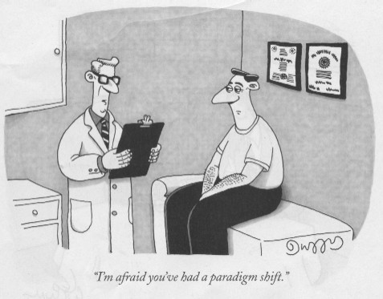

Slide 20
Gene-Environment Interactions and Epigenetic Processes (Level 2)
Immune abnormalities/
inflammation
Oxidative stress
Disturbed methylation
Mitochondrial dysfunction
Free fatty acid metabolism
Excitatory/inhibitory imbalance
Hormonal effects
Microglia/Astrocytes
Microbiome
Goines P, et al. Curr Opin Neurol. 2010;23(2):111-117. James SJ, et al. Am J Clin Nutr. 2009;89(1):425-430. Frye RE, et al. Pediatr Res. 2011;69(5 Pt 2):41R-47R. Manji H, et al. Nat Rev Neurosci. 2012;13(5):293-307. Bell JG, et al. Br J Nutr. 2010;103(8):1160-1167. Rubenstein JL. Curr Opin Neurol. 2010;23(2):118-123. Harony H, et al. Neurosignals. 2010;18(2):82-97. Cunningham CL. J Neurosci. 2013;33(10):4216-4233.
Notes:
Biomedical/epigenetic
Level 1 – Gene modification

Slide 21
A New Paradigm (Grade C Mod)
Significant subsets of people with autism have intestinal inflammation, digestive enzyme abnormalities, metabolic impairments, oxidative stress, mitochondrial dysfunction, and immune problems that range from immune deficiency to hypersensitivity to autoimmunity
In many cases, improvement of autistic symptoms is achieved by a combination of nutritional recommendations, prescription medications, and addressing the underlying medical conditions seen in these individuals
Mumper E. North American Journal of Medicine and Science. 2012;5(3):180-184.

Slide 22
Targeting Shared Mechanisms
Immune/Inflammation
Melatonin (Grade B Mod; Rec)
IV/IG (Grade D Low; Poor)
Corticosteroids (Grade D Low; Poor)
Vitamin D (Grade B Mod; Rec)
Suramin (Grade C Low; insuff)
HBOT (Grade D Low; Poor
Mitochondrial Function
Carnitine (Grade C Low; Insuff)
CoQ10 (Grade C Mod; Insuff)
L-carnosine (Grade C Low; Insuff)
Asadabadi M, et al. Psychopharmacology. 2013;225(1):51-59. Suren P, et al. JAMA. 2013;309(6):570-577. Rossignol DA, et al. Mol Psychiatry. 2012;17(4):389-401. Delhey LM et al. J Clin Med, 2017

Slide 23
Targeting Shared Mechanisms
Oxidative Stress
Glutathione (Grade I Low; insuff)
Methyl B12 (Grade B Mod; neutral)
Curcumin – anti-inflammatory and antioxidant activity (Grade I Low; insuff)
NAC (Grade B Mod; rec)
Sulforaphane (Grade C Mod; consider)
Neurotransmitter Production
Tetrahydrobiopterin (Grade I Low; insuff)
Rivastigmine & donepezil– parasympathomimetic or cholinergic agent (Grade I Mod; insuff)
Galantamine – acetylcholinesterase inhibitor (Grade I Mod; insuff)
GABA
Arbaclofen (STX209) (Grade D Mod; ineff)
Bumetanide – diuretic (Grade I Mod; insuff)
Glutamate
Riluzole – used to treat amyotrophic lateral sclerosis (Grade I Mod; insuff)
D-cycloserine – partial agonist of the neuronal NMDA receptor (Grade B Mod; insuff)
NMDA = N-methyl-D-aspartate
Kern JK, et al. Med Sci Monit. 2011;17(12):CR677-CR682. Bertoglio K, et al. J Altern Complement Med. 2010;16(5):555-560. Darvesh AS, et al. Expert Opin Investig Drugs. 2012;21:1123-1140. Frye RE, et al. Transl Psychiatry. 2013:e237. Chez MG, et al. J Child Neurol. 2004;19(3):165-169. Nicolson R, et al. J Child Adolesc Psychopharmacol. 2006;16(5):621-629. Wang P, et al. Presented at: International Society for Autism Research; May 14, 2011; San Diego, CA. Abstract 8281. Hadjikhani N, et al. Autism. 2013;Epub ahead of print. Wink LK, et al. J Child Adolesc Psychopharmacol. 2011;21(4):375-379. Posey DJ, et al. Am J Psychiatry. 2004;161(11):2115-2117.

Slide 24
Metabolic/Amino Acids/Nutrient
Omega 3 (Grade B Mod; rec)
B6/Magnesium (Grade I Mod; insuff)
Folic acid (Grade C Mod; insuff)
Iron (Grade A Low; rec if indicated)
Ascorbic acid (Grade I Low; insuff)
Zinc and copper (Grade I Low- insuff)
Inositol (Grade I low; insuff)
Diet (Grade I low; insuff)
Oxytocin (Grade C Mod; insuff)
Microbiome
Probiotics (Grade B Mod; insuff)
Pancreatic Digestive Enzymes (Grade C Mod; insuff)
Cheng JX, et al. Adolesc Med State Art Rev. 2013;24(2):446-464. Lofthouse N, et al. Autism Res Treat. 2012;2012:870391.

Slide 25
Other Considerations
Medical marijuana/THC/CBD and the endocannabinoid systems (Grade I, Low; insuff)
http://www.nationalacademies.org/hmd/Reports/2017/health-effects-of-cannabis-and- cannabinoids.aspx
Acupuncture (Grade B, Moderate, not conclusive)
Acupuncture complementary to behavioral and educational interventions decreased CARS (MD -8.10, 95% CI -12.80 to 33.40) and the Autism Behavior Checklist (MD-8.92, 95% CI -11.29 to -6.54); however, it was unclear which of the ASD symptoms improved.
Heterogeneous methods
THC = tetrahydrocannabinol; CBD = cannabidiol.
Lee et al., Evid Based Complement Alternat Med. 2018

Slide 26
Lifting the Veil
of Autism

