Slide 1
Psychiatric Mental Health Program
Challenging Behaviors in Autism (but not exclusive to ASD).
Carmen Lopez-Arvizu, MD
Neurodevelopmental Consultation Clinic
Medical Director of Psychiatric Mental Health Program at Kennedy Krieger Institute
Current President of Medical Staff at Kennedy Krieger Institute
Member of the EDI Council (called IDEAS: Inclusion Diversity Equity Anti-isms and Social Justice)
Office for Health, Equity, Inclusion, and Diversity at Kennedy Kriger Institute.
Assistant Professor of Psychiatry
Johns Hopkins School of Medicine

Slide 2
Faculty Disclosures
Grant funding from Governor’s office of Crime control and Prevention (Maryland).
No other.

Slide 3
What matters the most to me.
What matters the most to me…..
Neurodevelopmental Consultation Clinic.
Medical Director of Psychiatric Mental Health Program at Kennedy Krieger Institute
Current President of Medical Staff at Kennedy Krieger Institute
Member of the EDI Council (called IDEAS: Inclusion Diversity Equity Anti-isms and Social Justice)
Office for Health, Equity, Inclusion, and Diversity at Kennedy Krieger Institute.
Assistant Professor of Psychiatry, Johns Hopkins School of Medicine

Slide 4
Neurodevelopmental Consultation Clinic
Offers consultation to other professionals
EVALUATE AND EDUCATE
Chief complaint
  “behavior problem”

Slide 5
Neurodevelopmental Consultation Clinic
What is/is not challenging behavior
What is “within normal”
What is pathological
What is next?
What do I do?

Slide 6
Presentation title goes here
But first….
• What is a challenging behavior?

Slide 7
Challenging behavior
Culturally abnormal behavior of such intensity, frequency or duration that the physical safety of the person or others is placed in serious jeopardy, or behavior which is likely to seriously limit or deny access to the use of ordinary community facilities

Slide 8
Types of Challenging Behaviors
Noncompliance with directives
Repetitive Behaviors
Restricted interests
Sleep problems
Mood instability and “emotional” meltdowns.
Aggression
Self-injurious behavior

Slide 9
Does it interfere with QOL?
ABSOLUTELY!
Limits safety
Limits access to everything!

Slide 10
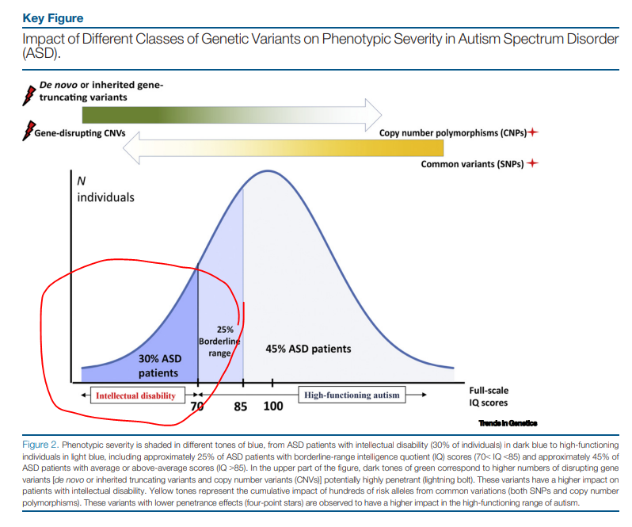
Who is our focus today?
Who are we talking about today?

Slide 11
Challenging Behaviors
“Challenging behavior" is often (not always) a reaction to the environment that services (school, stores) or others (families) create around people with developmental disabilities.
Most common are communication difficulties

Slide 12
And…
Before thinking about how to “treat” challenging behaviors, we need to ask why they are there?

Slide 13
Case #1
10 y/o with ASD, hearing and vision impairment, non-ambulatory. Severe to profound ID (genetic syndrome).
CC: “She is disruptive in class and not able to participate in learning”….

Slide 14
Case #1
What:
  She “flip-flops” on the floor, smiling, looking up to the ceiling.
When:
  in class during circle time.
What do you do?:
  “we talk to her”

Slide 15
Environmental
Noise
Lights
Heights
Speed
Or worst: all.
Let’s go to the July 4th fireworks to the DC Mall….

Slide 16
Case #1
My Intervention:
  “disruptive”
  the why and when.
  Sensory input.
  Intervenor (works with blind students)

Slide 17
Case #2
12 y/o with seizure d/o, ID, static encephalopathy of unknown origin, ASD.
Seen at ER for swollen face from self-punching.
ER told mom “this is normal,” (because of his disability) and sent home.

Slide 18
Case #2
I saw him at the request of his PCP.
First question:
Did anyone check his mouth??
Answer: of course not…….
Dental Abscess

Slide 19
Physical
Don’t feel well
Pain
Tired

Slide 20
Case #3
10 y/o with average cognitive functioning and ASD.
  Family going to amusement park for Halloween.
  Refuses to get in the car.
  Throws her shoes at mom.
  Screams

Slide 21
Case #3
It is October (Monsterfest)
They are going to Six Flags.
Siblings are older and want to ride roller coasters.
Totally get it!!!!

Slide 22
Social
I am bored.
Attention
Communication Difficulties.
No, I don’t want to!

Slide 23
Case #4
10 y/o ASD
Head-slapping
Crying
Reduced toy play
Decreased talking

Slide 24
Case # 4
Hiding under chair at home and school
Laying in bed
Loss of appetite

Slide 25
Psychiatric Disorders.
Mental health problems (same thing)
Depression
Anxiety
Mood disorder
Psychosis
Trauma
Sleep disorder.

Slide 26
Psychiatric Disorder
Having a developmental disability does NOT exclude you from having a psychiatric disorder.

Slide 27
Comorbidities.
Co-occurring conditions in ASD:
Depression (affecting 2-30%)
ADHD (affecting 29-83%)
OCD (1.8-81%)
Anxiety disorders (2.9-35%)
Variable….is it because not all are diagnosed?

Slide 28
DSM-5 or DSM-ID
Depending on intellectual functioning it can be a more a bit more difficult to identify.
DSM-V (Diagnostic Statistical Manual of Mental Disorders)…not exactly
But DSM-ID-IV - behind the current times
but better than nothing

Slide 29
Diagnosis
Both, manuals are diagnostic GUIDES, and are not set in stone.
Patients are people.
We don’t read the manual to have symptoms.

Slide 30
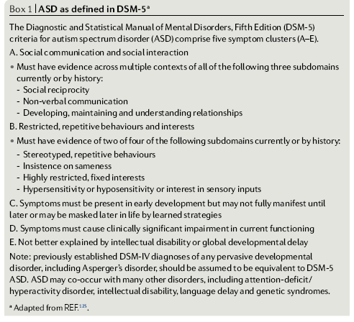
ASD by DSM-5

Slide 31
Challenging behaviors
Happen all the time.
Some are part of psychiatric comorbidities
Some are not.
How to treat?.....
Coming up…..

Slide 32
When is not “just” a behavior
The first step on addressing this is to find out a possible cause of such behaviors.

Slide 33
Treatment
The same is with treatment.
There are no recipes.
Treatment is decided extrapolated from the current research

Slide 34
Plan A
Non pharmacological options
IF possible.
Psychopharmacology should not be the first choice for challenging behaviors.

Slide 35
Plan B
Can be a very effective second choice.
Avoid monotherapy, should always with combination treatment. Behavior therapy, parent training, etc.

Slide 36
Treatment
The first step on addressing this is to find out a possible cause of such behaviors.
That is where ABA comes in: what is the behavior and what is the function of it?
A common principle in behavior management is looking for the message an individual is communicating through their challenging behavior: "All behavior has meaning". This is a core in the functional analysis process (ABA).

Slide 37
Is it ok for my child?
Always askd:
What is the Side effect profile?
Risk vs Benefit?

Slide 38
FDA approved
Age
Indication

Slide 39
About Psychopharmacology
Psychopharmacology categories
Indications
Side effect profile

Slide 40
ADHD Medications
Stimulants
  Methylphenidate
  Amphetamine salts
    (many brands and combinations of immediate release and extended release formulations)
Non-Stimulant:
  Atomoxetine (Strattera®)

Slide 41
Antidepressants
Selective Serotonin Reuptake Inhibitors (SSRI)
Citalopram (Celexa®) FDA approved in kids age 12 and above
Escitalopram (Lexapro®)
Fluoxetine (Prozac®) FDA approved in kids 7 and above.
Fluvoxamine (Luvox®) FDA approved in kids 7 and above.
Paroxetine (Paxil®)
Sertraline (Zoloft®) FDA approved in kids 6 and above

Slide 42
Antidepressants
Dopamine Reuptake Inhibitor (Norepinephrine NDRI)
Bupropion (Wellbutrin®)
Serotonin Norepinephrine Reuptake Inhibitor (SNRI)
Esvenlafaxine (Pristiq®)
Duloxetine (Cymbalta®)
Levomilnacipran (Fetzima®)
Venlafaxine (Effexor®)

Slide 43
Antidepressants
Serotonin-2 Antagonists/Reuptake Inhibitors (SARI)
Trazodone (Desyrel®)
Noradrenergic/Specific Serotonergic Antidepressants (NaSSA)
Mirtazapine (Remeron®)
Tricyclic antidepressants
Amitriptyline (Elavil®)
Desipramine (normpramin®)
Doxepin
Imipramine (Tofranil®)
Notriptyline
Amoxapine

Slide 44
Other agents
Alpha-2 Adrenergic Agonists
Guanfacine (Tenex or Intuniv®)
Clonidine (Kapvay®)

Slide 45
Mood Stabilizers
(Anti-epileptic agents)
Valproic acid (Depakote®)
Valproate (Depakote ER®)
Lamotrigine (Lamictal®)
Neurontin (Gabapentin®)
Carbamazepine (Tegretol®)
Oxcarbazepine (Trileptal®)
Topiramate (Topamax®)

Slide 46
Mood Stabilizers
Not all antiseizure meds have mood stabilizer properties.
NOT Zonegram=Keppra®
Other mood stabilizer: Lithium not an anti-seizure medication.

Slide 47
Antipsychotics
Risperdal ® (risperidone) FDA approved in kids
Fanapt® (iloperidone)
Invega® (paliperidone)
Zyprexa® (olanzapine)
Seroquel® (quetiapine)
Geodon®® (ziprasidone)
Clozaril (clozapine)
Abilify® (aripiprazole) FDA approved in kids
Saphris® (Asenapine)
Latuda® (lurasidone)

Slide 48
Benzodiazepines
Alprazolam (Xanax®)
Chlordiazepoxide (Librium®)
Diazepam (Valium®)
Halazepam (Paxipam®)
Lorazepam (Ativan®)
Oxazepam (Serax®)
Prazepam (Centrax®)
Quazepam (Doral®)
Other GABA agonists: Zaleplon, Zolpidem

Slide 49
What is used for what?
How is it decided?
What is the data?
Coming up next….

